Slide 1
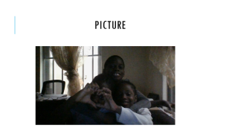
I love my mom AND DAD
OLUWASEESE, OLUWASEMILORE,OLUWANINI
BABATOMS

Slide 2
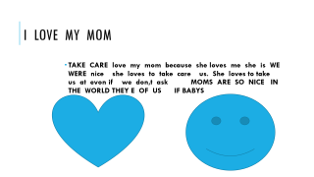
I love my dad
I he love love my dad because he is nice he loves to play with us if we ask him to buy something he will buy for us if we say please .
I love my dad so much because he is awsome and nice us

Slide 3
I love my mom
TAKE CARE love my mom because she loves me she is WE WERE nice she loves to take care us. She loves to take us at evon if we don,t ask MOMS ARE SO NICE IN THE WORLD THEY E OF US IF BABYS

Slide 4
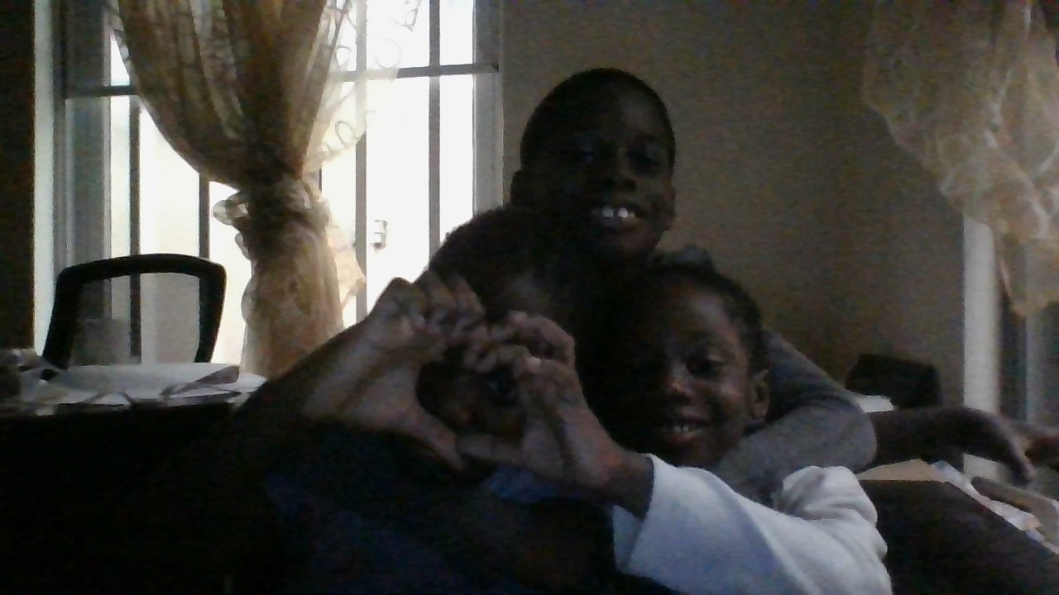
PICTURE

Slide 5
END
THANKS YOU FOR READING
THE END

Slide 6
ART

Slide 7
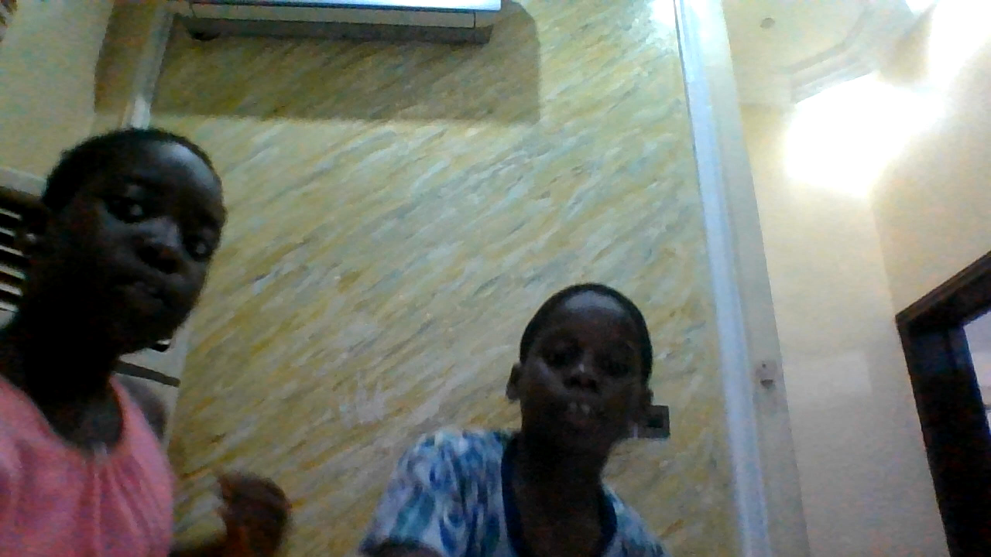
SONG FOR MOM AND DAD

